Slide 1
Lect 13-14
CSE202: OBJECT ORIENTED PROGRAMMING
1

Slide 2
Outline
Introduction to Pointers
Applications of Pointers
Limitations of Pointers
Reference Variables
Difference between Reference variable and pointers
Void Pointers
Pointer arithmetic
Pointer to Pointer

Slide 3
Introduction to Pointers
When we declare a variable some memory is allocated for it. Thus, we have two properties for any variable : its address and its data value. The address of the variable can be accessed through the referencing operator “&”. “&i” gives the memory location where the data value for “i” is stored.
A pointer variable is one that stores an address. We can declare pointers as follows int *p; This means that p stores the address of a variable of type int.

Slide 4
Variable
Variables are containers for storing data values, like numbers and characters.
A variable is a named memory location.
Variables provide direct access to its memory location.
A variable has a name, an address, a type,and a value:
"the name identifies the variable to the programmer
"the address specifies where in main memory the variable is located

Slide 5
Declaration of Variable
Syntax-
type variableName = value;
where type is one of C++ types (such as int), and variableName is the name of the variable (such as x or myName). The equal sign is used to assign a value to the variable.
Example-
int myNum = 15;

Slide 6
How to use a Pointer
Define a pointer variable
Assigning the address of a variable to a pointer using the unary operator (&) which returns the address of that variable.
Accessing the value stored in the address using unary operator (*) which returns the value of the variable located at the address specified by its operand.

Slide 7
Pointer Variable Declaration
A pointer is a variable that contains the memory location of another variable.
Syntax-
datatype *pointervar_name;
Example-
int *ptr; // ptr can point to an address which holds int data
The asterisk tells the compiler that you are creating a pointer variable.

Slide 8
Pointer Variable Initialization
To initialize a pointer variable first we have to declare a variable whom to be pointed by a pointer variable. So the form of pointer variable initialization is:
Syntax-
data_type variable_name, *pointer _variable;
pointer_variable=&variable_name;
Example-
int myNum, *ptr;
ptr=&myNum;

Slide 9
Cont..
We can declare and initialize in one statement also:
Example-
int myNum=15;
int *ptr=&myNum;

Slide 10
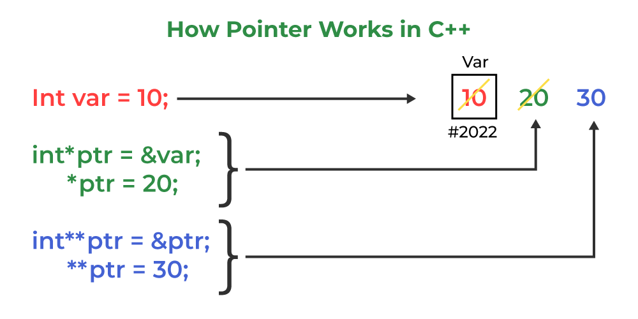
How Pointer Works in C++

Slide 11
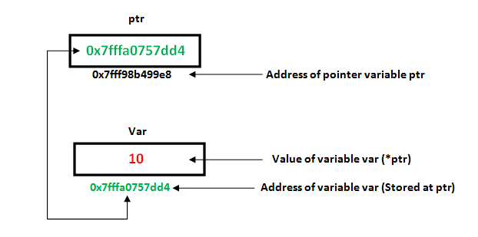

Slide 12
Example
#include<iostream>
using namespace std;
int main ()
{
int myNum = 10;
int *ptr;
ptr = &myNum; // pointer ptr is pointing to the address of myNum
cout<<"Address of myNum:"<<ptr; // Address of myNum will be printed
cout<<"\nValue stored at ptr:"<<*ptr;
// value stoted at the address contained by ptr i.e. 10 will be printed
return 0;
}

Slide 13
MCQ 1.
Which of the following is the correct way to declare a pointer ?
A. int *ptr ; B. int ptr ; C. int &ptr ; D. All of the above

Slide 14
Solution
Which of the following is the correct way to declare a pointer ?
A. int *ptr ; B. int ptr ; C. int &ptr ; D. All of the above

Slide 15
MCQ
Comment on the following pointer declaration?
int *ptr, p;
a) ptr is a pointer to integer, p is not b) ptr and p, both are pointers to integer c) ptr is pointer to integer, p may or may not be d) ptr and p both are not pointers to integer

Slide 16
Solution
Comment on the following pointer declaration?
int *ptr, p;
a) ptr is a pointer to integer, p is not b) ptr and p, both are pointers to integer c) ptr is pointer to integer, p may or may not be d) ptr and p both are not pointers to integer

Slide 17
Applications of Pointers
To pass arguments by reference.
For accessing array elements- Compiler internally uses pointers to access array elements.
To implement data Structures
Dynamic Memory Allocation- We can use pointers to dynamically allocate memory. The advantage of dynamically allocated memory is, it is not deleted until we explicitly delete it.

Slide 18
MCQ
Which of the following is the application of pointer
To pass arguments by reference.
For accessing array elements.
To implement data structures(linked-list ,binary tree,graph).
All of the above

Slide 19
Solution
Which of the following is the application of pointer
To pass arguments by reference.
For accessing array elements.
To implement data structures(linked-list ,binary tree,graph).
All of the above

Slide 20
Reference Variable
A reference variable is an alias, that is, another name for an already existing variable. A reference, like a pointer, is also implemented by storing the address of an object. A reference can be thought of as a constant pointer (not to be confused with a pointer to a constant value!) with automatic indirection, i.e., the compiler will apply the * operator for you.
Syntax-
data_type &ref = variable;
int i = 3; // A pointer to variable i or "stores the address of i“
int *ptr = &i;
int &ref = i; // A reference (or alias) for i.

Slide 21
Example
#include <iostream>
using namespace std;
int main()
{
int x = 10;
int& ref = x;
// ref is a reference to x.
ref = 20;
// Value of x is now changed to 20
cout << "x = " << x << '\n';
x = 30;
// Value of x is now changed to 30
cout << "ref = " << ref << '\n';
return 0;
}
Output:
x = 20 ref = 30

Slide 22
References vs Pointers
1. Initialization: A pointer can be initialized in this way:
int a = 10; int *p = &a; // OR int *p; p = &a;
We can declare and initialize pointer at same step or in multiple line.
While in references,
int a = 10;
int &p = a; // It is correct //
but int &p;
p = a; // It is incorrect
as we should declare and initialize references at single step
NOTE: This difference may vary from compiler to compiler.

Slide 23
References vs Pointers
2. Reassignment: A pointer can be re-assigned. This property is useful for the implementation of data structures like a linked list, a tree, etc. See the following example:
int a = 5;
int b = 6;
int *p;
p = &a;
p = &b;
On the other hand, a reference cannot be re-assigned, and must be assigned at initialization.
int a = 5;
int b = 6;
int &p = a;
int &p = b; // This will throw an error of "multiple declaration is not allowed"

Slide 24
References vs Pointers
3. Memory Address: A pointer has its own memory address and size on the stack, whereas a reference shares the same memory address with the original variable but also takes up some space on the stack.
int &p = a;
cout << &p << endl << &a;
4. NULL value: A pointer can be assigned NULL directly, whereas a reference cannot be. The constraints associated with references (no NULL, no reassignment) ensure that the underlying operations do not run into an exception situation.

Slide 25
References vs Pointers
5. Indirection: You can have a pointer to pointer (known as a double pointer) offering extra levels of indirection, whereas references only offer one level of indirection. For example,
In Pointers, int a = 10;
int *p;
int **q; // It is valid.
p = &a;
q = &p; // Whereas in references,
int &p = a;
int &&q = p; // It is reference to reference, so it is an error

Slide 26
References vs Pointers
6. Arithmetic operations: Various arithmetic operations can be performed on pointers, whereas there is no such thing called Reference Arithmetic.

Slide 27
References vs Pointers
 | References | Pointers
Reassignment | The variable cannot be reassigned in Reference. | The variable can be reassigned in Pointers.
Memory Address | It shares the same address as the original variable. | Pointers have their own memory address.
Work | It is referring to another variable. | It is storing the address of the variable.
Null Value | It does not have null value. | It can have value assigned as null.
Arguments | This variable is referenced by the method pass by value. | The pointer does it work by the method known as pass by reference.
Reassignment | The variable cannot be reassigned in Reference. | The variable can be reassigned in Pointers.
Memory Address | It shares the same address as the original variable. | Pointers have their own memory address.

Slide 28
Applications of reference variables
C and C++ support pointers, which is different from most other programming languages such as Java, Python, Ruby, Perl and PHP as they only support references. But interestingly, C++, along with pointers, also supports references.
There are multiple applications for references in C++, a few of them are mentioned below:
Modify the passed parameters in a function
Avoiding a copy of large structures
In For Each Loop to modify all objects
For Each Loop to avoid the copy of objects

Slide 29
1. Modify the passed parameters in a function
#include <iostream>
using namespace std;
// Function having parameters as
// references
void swap(int& first, int& second)
{
int temp = first;
first = second;
second = temp;
}
int main()
{
int a = 2, b = 3;
// function called
swap(a, b);
// changes can be seen
// printing both variables
cout << a << " " << b;
return 0;
}
Output- 3 2

Slide 30
Limitations of Reference variables
Once a reference is created, it cannot be later made to reference another object; it cannot be reset. This is often done with pointers.
References cannot be NULL. Pointers are often made NULL to indicate that they are not pointing to any valid thing.
A reference must be initialized when declared. There is no such restriction with pointers.
References in C++ cannot be used for implementing data structures like Linked List, Tree, etc. In Java, references don’t have the above restrictions and can be used to implement all data structures. References being more powerful in Java is the main reason Java doesn’t need pointers.

Slide 31
Void Pointer
A void pointer is a pointer that has no associated data type with it. A void pointer can hold an address of any type and can be typecasted to any type.
Syntax-
void *ptr;
In C++, we cannot assign the address of a variable to the variable of a different data type. Consider the following example:
int *ptr; // integer pointer declaration
float a=10.2; // floating variable initialization
ptr= &a; // This statement throws an error.

Slide 32
Example
#include <iostream.h>
using namespace std;
int main()
{
int *ptr;
float f=10.3;
ptr = &f; // error
cout << "The value of *ptr is : " <<*ptr<< endl;
return 0;
}

Slide 33
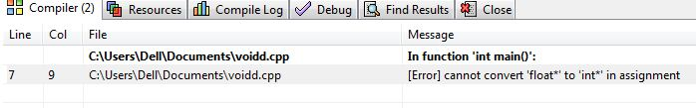
Output

Slide 34
Example of void pointer
#include<iostream>
using namespace std;
int main()
{
int x = 4;
float y = 5.5;
//A void pointer
void *ptr;
ptr = &x;
cout<<"Integer variable is = "<<( *(int*) ptr) ;
// void pointer is now float
ptr = &y;
cout<<"\nFloat variable is= "<< ( *(float*) ptr) ;
return 0;
}
Output-
Integer variable is = 4
Float variable is = 5.5

Slide 35
MCQ
Which of the following syntax can be used for typecast the void pointer variable
*((int*)ptr)
*((float*)ptr)
(int*)ptr
Both a and b

Slide 36
Difference between void pointer in C and C++
In C, we can assign the void pointer to any other pointer type without any typecasting, whereas in C++, we need to typecast when we assign the void pointer type to any other pointer type.

Slide 37
Example in C
#include <stdio.h>
int main()
{
void *ptr; // void pointer declaration
int *ptr1; // integer pointer declaration
int a =90; // integer variable initialization
ptr=&a; // storing the address of 'a' in ptr
ptr1=ptr; // assigning void pointer to integer pointer type.
printf("The value of *ptr1 : %d",*ptr1);
return 0;
}
Output-
The value of *ptr1 : 90

Slide 38
Example in C++
#include <iostream>
using namespace std;
int main()
{
void *ptr; // void pointer declaration
int *ptr1; // integer pointer declaration
int data=10; // integer variable initialization
ptr=&data; // storing the address of data variable in void pointer variable
ptr1=(int *)ptr; // assigning void pointer to integer pointer
cout << "The value of *ptr1 is : " <<*ptr1<<endl;
return 0;
}
Output-
The value of *ptr1 is : 10

Slide 39
Pointers Arithmetic
Valid operations on pointers include:
- the sum of a pointer and an integer
the difference of a pointer and an integer
Assignment operator used in pointers
- Pointer comparison
the difference of two pointers.
Increment/decrement in pointers

Slide 40
Assignment in Pointers
Pointer variables can be "assigned": int *p1, *p2; p2 = p1;
Assigns one pointer to another
Make p2 point to where p1 points
Do not confuse with: *p1 = *p2;
Assigns "value pointed to" by p1, to "value pointed to" by p2

Slide 41
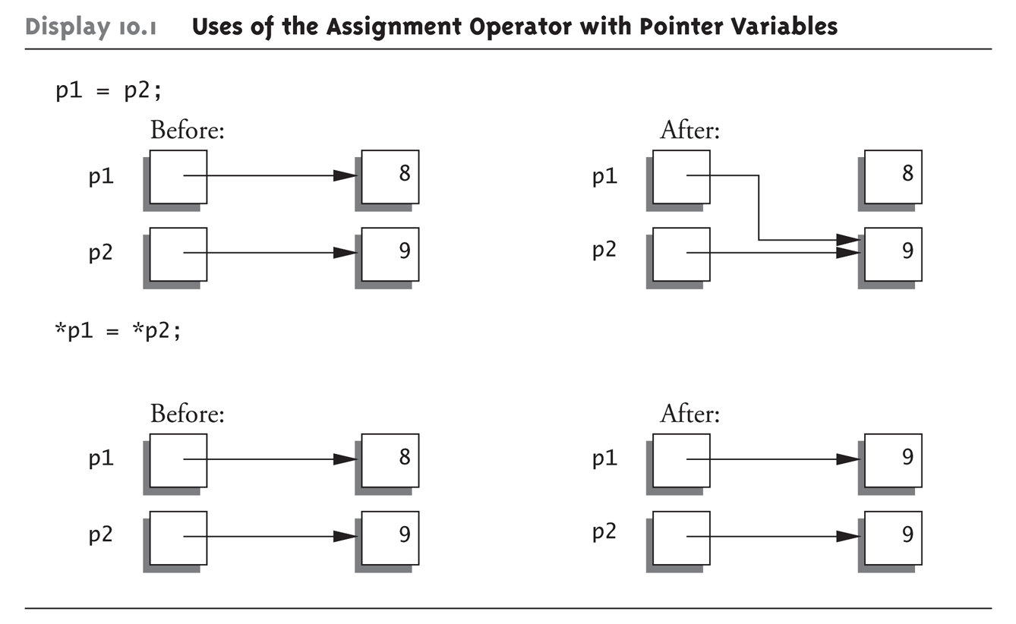
Diagrammatic representation

Slide 42
Example
#include<iostream>
using namespace std;
int main()
{
int x=10;
int *ptr1;
int *ptr2;
ptr1= &x;
ptr2 = ptr1;
*ptr2 = *ptr1;
cout<<" \nvalue of x is:"<<x;
cout<<" \nvalue of ptr1 is :"<<ptr1;
cout<<" \nvalue of ptr2 is :"<<ptr2;
cout<<" \nvalue at address which ptr1 point to :"<<*ptr1;
cout<<" \nvalue at address which ptr2 point to :"<<*ptr2;
}

Slide 43
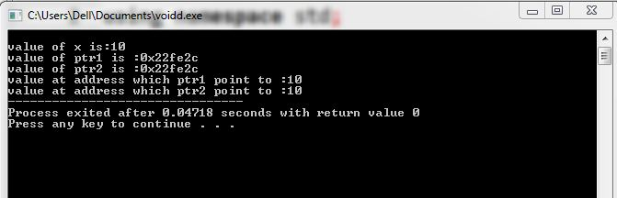
Output

Slide 44
MCQ
What will happen in the following C++ code snippet?
int a = 100, b = 200;
int *p = &a, *q = &b;
p = q;
a) b is assigned to a b) p now points to b c) a is assigned to b d) q now points to a

Slide 45
Solution
What will happen in the following C++ code snippet?
int a = 100, b = 200;
int *p = &a, *q = &b;
p = q;
a) b is assigned to a b) p now points to b c) a is assigned to b d) q now points to a

Slide 46
Swap two numbers using pointers
#include<iostream>
using namespace std;
int main()
{
int x, y, *a, *b, temp;
cout<<"Enter the value of x and y\n";
cin>>x>>y;
cout<<"Before Swapping\nx = "<<x<<" \ny = "<<y;
a = &x;
b = &y;
temp = *b;
*b = *a;
*a = temp;
cout<<"\nAfter Swapping\nx ="<<x<<" \ny = "<<y;
}

Slide 47
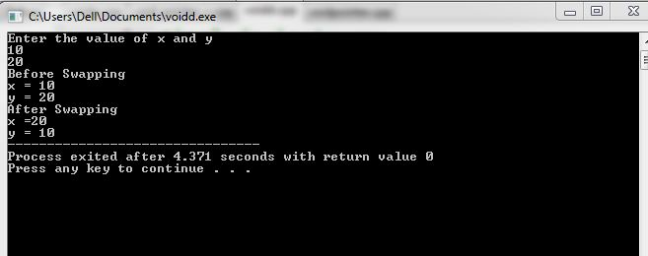
Output

Slide 48
Comparison in Pointers
Two pointers of the same type, p and q, may be compared using the <, >, <=, >=, == , !=
When you are comparing two pointers, you are comparing the
values of those pointers rather than the contents of memory locations pointed to by these pointers

Slide 49
Increment and decrement
The increment (++) operator increases the value of a pointer by the size of the data object the pointer refers to. For example, if the pointer refers to the second element in an array, the ++ makes the pointer refer to the third element in the array.
The decrement (--) operator decreases the value of a pointer by the size of the data object the pointer refers to. For example, if the pointer refers to the second element in an array, the -- makes the pointer refer to the first element in the array.

Slide 50
You can add an integer to a pointer but you cannot add a pointer to a pointer.
If the pointer p points to the first element in an array, the following expression causes the pointer to point to the third element in the same array:
p = p + 2; If you have two pointers that point to the same array, you can subtract one pointer from the other. This operation yields the number of elements in the array that separate the two addresses that the pointers refer to.

Slide 51
Increment and Decrement
Data Type | Initial address | Operation | Address after operations | Required bytes
Int i=2 | 4046 | ++ | -- | 4048
Char c=‘x’ | 4053 | ++ | -- | 4054
Float f=2.2 | 4050 | ++ | -- | 4054
Long l=2 | 4060 | ++ | -- | 4064

Slide 52
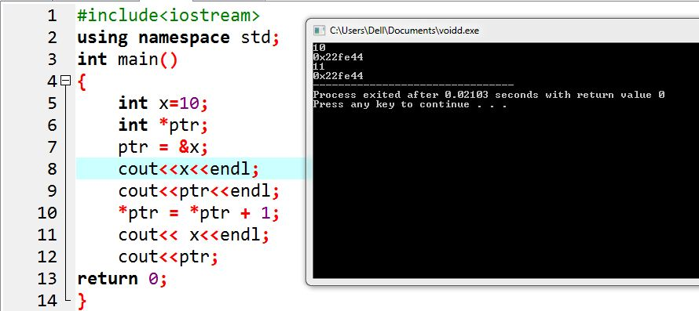
Example 1

Slide 53
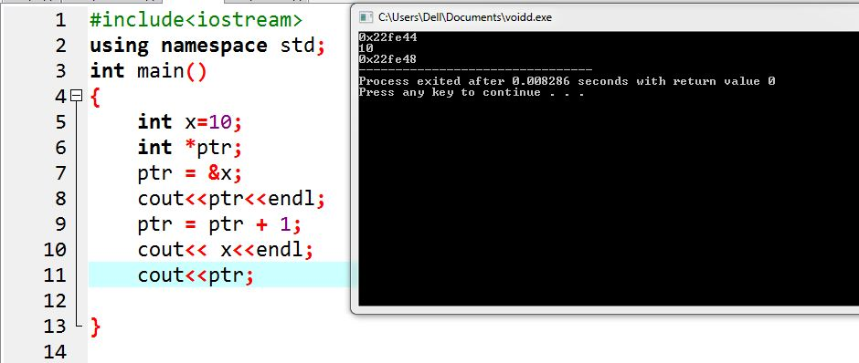
Example 2

Slide 54
Pointer to Pointer
We already know that a pointer stores the memory address of other variables.
So, when we define a pointer to a pointer, the first pointer is used to store the address of the variables, and the second pointer stores the address of the first pointer. For this very reason, this is known as a Double Pointer or Pointer to Pointer.

Slide 55
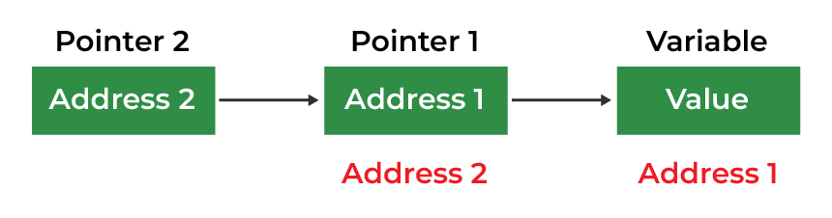

Slide 56
How to Declare a Pointer to a Pointer in C ++
Declaring a Pointer to Pointer is similar to declaring a pointer in C++. The difference is we have to use an additional * operator before the name of a Pointer in C++.
Syntax
data_type_of_pointer **name_of_variable = & normal_pointer_variable;
Example:
int val = 169;
int *ptr = &val; // storing address of val to pointer ptr.
int **double_ptr = &ptr; // pointer to a pointer declared which is pointing to an integer.

Slide 57
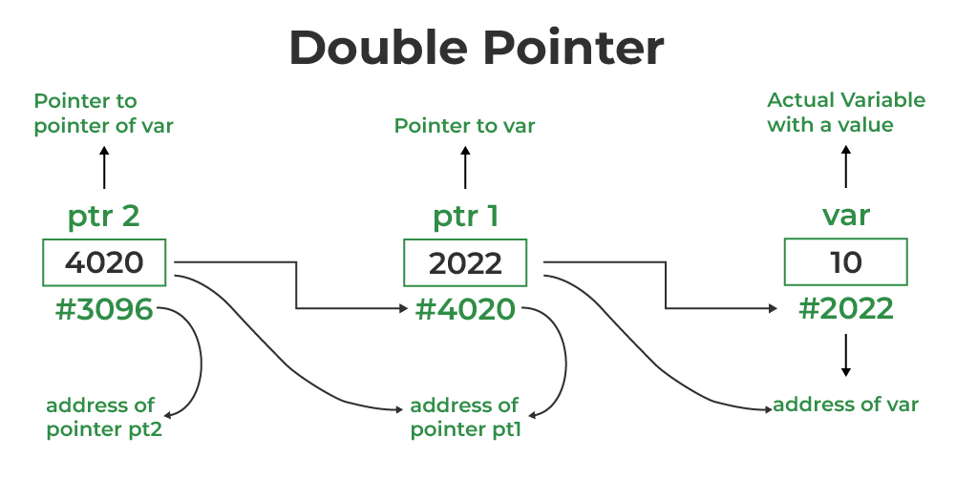

Slide 58
Example
#include<iostream>
using namespace std;
int main ()
{
int a = 10;
int *p;
int **pp;
p = &a; // pointer p is pointing to the address of a
pp = &p; // pointer pp is a double pointer pointing to the address of pointer p
cout<<"address of a:"<<p<<endl; // Address of a will be printed
cout<<"address of p:"<<pp<<endl; // Address of p will be printed
cout<<"value stored at p: "<<*p<<endl;
cout<<"value stored at pp: "<<*pp<<endl; // value stoted at the address contained by p i.e. 10 will be printed
cout<<"value stored at pp: "<<**pp; // value stored at the address contained by the pointer stored at pp
}

Slide 59
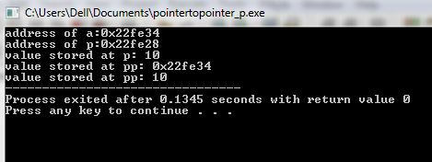
Output

Slide 60
MCQ
#include <iostream>
using namespace std;
int main()
{
int x = 4;
void* ptr;
ptr = &x;
cout<<“value of x”<<*ptr;
}
What will be the output for
this code?
a) 4
b) Compile time error
c) Give some memory address
d) none

Slide 61
Solution
#include <iostream>
using namespace std;
int main()
{
int x = 4;
void* ptr;
ptr = &x;
cout<<“value of x”<<*ptr;
}
What will be the output
for this code?
a) 4
b) Compile time error
c) Give some memory address
d) none

